Slide 1
Sentiment Analysis (using Machine Learning)
By:
Shreyas Gambhirrao IT2129
Pruthviraj Mane Deshmukh IT2130
Ganesh Shinde IT2131
Aniket Tembhurne IT2132

Slide 2
Introduction
What is Sentiment Analysis?
API Creation
Data Pre-processing and Natural Language Processing.

Slide 3
What is Sentiment Analysis?
Sentiment Analysis is the most common text classification tool that analyses an incoming message and tells whether the underlying sentiment is positive, negative, or neutral.

Slide 4
Why do We use Sentiment Analysis?
Sentiment analysis is extremely useful in social media monitoring as it allows us to gain an overview of the wider public opinion behind certain topics.
It is an essential part of your market research and customer service approach. To see what people think of particular products or services, and what they think about your competitors too.

Slide 5
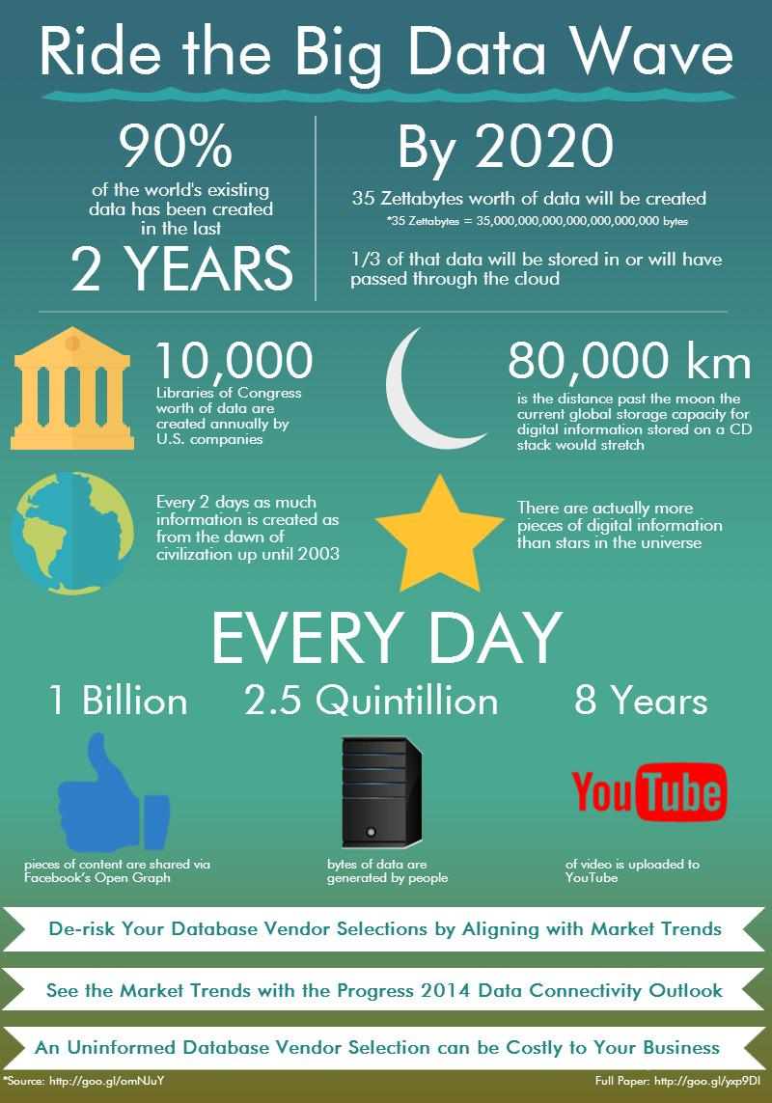

Slide 6
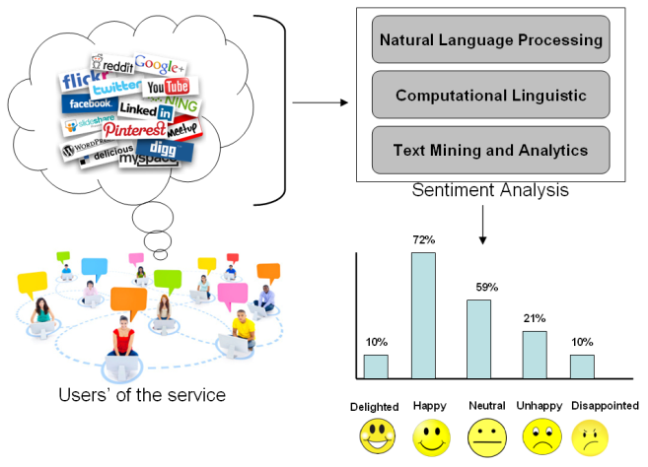

Slide 7
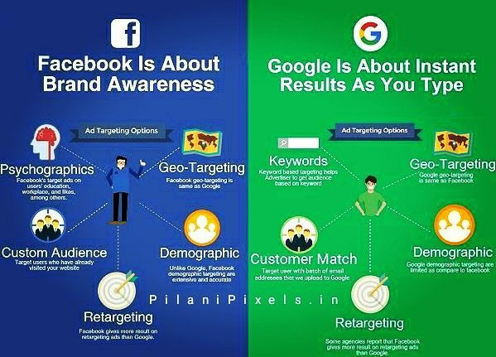
For Shreyash
For Shreyash

Slide 8
What is API?
API stands for Application Programming Interface. In the context of APIs, the word Application refers to any software with a distinct function. Interface can be thought of as a contract of service between two applications. This contract defines how the two communicate with each other using requests and responses.
APIs are mechanisms that enable two software components to communicate with each other using a set of definitions and protocols.

Slide 9
Types Of API
Private APIs. These application software interfaces are designed for improving solutions and services within an organization.
Partner APIs. Partner APIs are openly promoted but shared with business partners who have signed an agreement with the publisher.
Public APIs. Also known as developer-facing or external, these APIs are available for any third-party developers.

Slide 10
API management and security.
Many API management platforms support three types of security schemes. These are:
An API key that is a single token string (i.e. a small hardware device that provides unique authentication information).
Basic Authentication (APP ID / APP Key) that is a two token string solution (i.e. username and password).
OpenID Connect (OIDC) It verifies the user by obtaining basic profile information and using an authentication server

Slide 11
What is Data Pre-processing?
Data Pre-processing is the process done for a uniform textual type of data that is machine-understandable and processible by a machine learning model. Through this process, we get to data that has the context of future prediction.

Slide 12
Steps of Data Pre-processing :
Tokenization :
* Tokenization is the process of converting sentences into sets of separate words.
* Natural Language Toolkit(NLTK) is used for tokenization.

Slide 13
Steps of Data Pre-processing :
2. Stopwards :
* Removing unwanted words like ‘is, are, we, he, she, it, they, etc.
* By removing these words we do not lose the actual context of the textual data and we still know what data really indicates.

Slide 14
Steps of Data Pre-processing :
3. Normalization :
* Words that look different due to casing or written another way but are the same in meaning need to be processed correctly. Normalization processes ensure that these words are treated equally.

Slide 15
Steps of Data Pre-processing :
4. Lemmatization :
* Removing Symbols, Digits and Punctuation from the textual data to make data processible and understandable for the Machine Learning model.

Slide 16
What is NLP?
* NLP stands for Natural Language Processing.
* It is a process of predicting the outcome or deciding whether the particular data is Positive, Negative or Neutral.

Slide 17
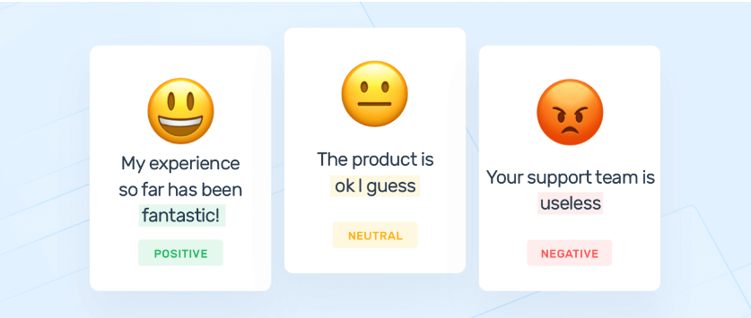

Slide 18
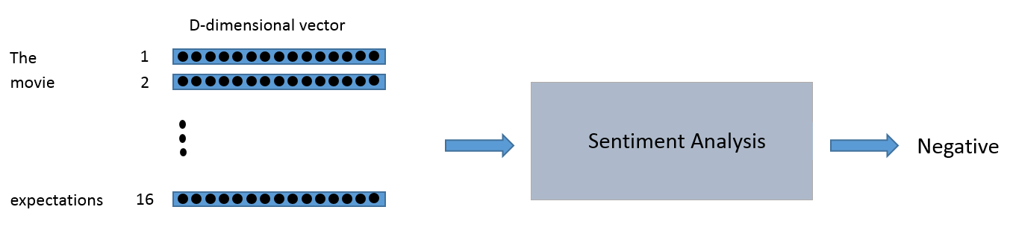
Word Vectors(Converting text to numbers)
You can think of the input to the sentiment analysis module as being a 16 x D dimensional matrix.

Slide 19
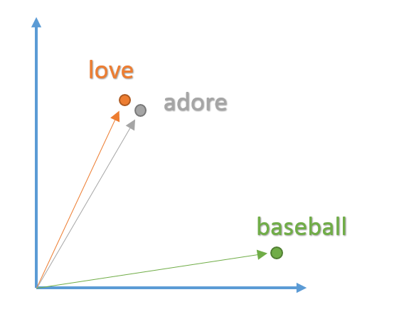
Reason for Word vector
We want these vectors to be created in such a way that they somehow represent the word and its context, meaning, and semantics. For example, we’d like the vectors for the words “love” and “adore” to reside in relatively the same area in the vector space since they both have similar definitions and are both used in similar contexts. The vector representation of a word is also known as a word embedding.

Slide 20
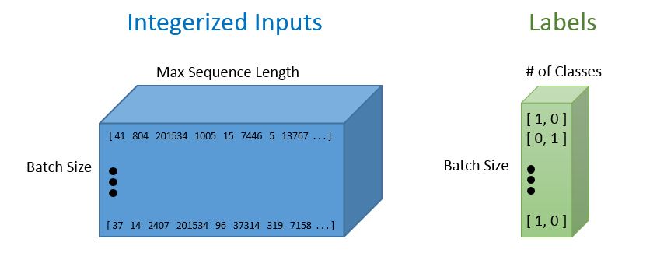
Tokenizing and pad_sequencing

Slide 21
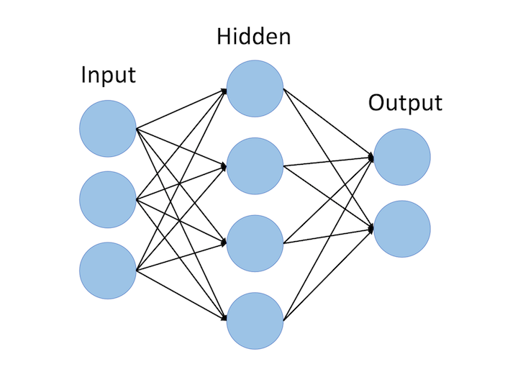
Recurrent Neural Networks (RNNs)
The recurrent neural network structure is a little different from the traditional feedforward NN you may be accustomed to seeing. The feedforward network consists of input nodes, hidden units, and output nodes.

Slide 22
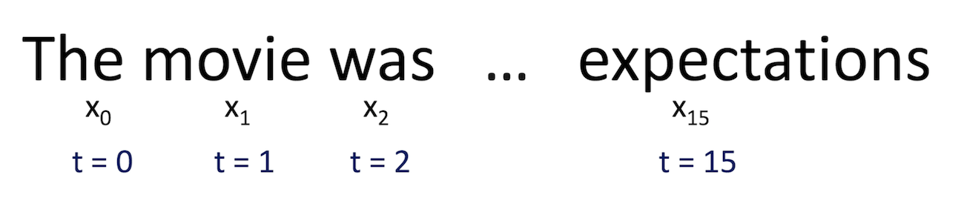
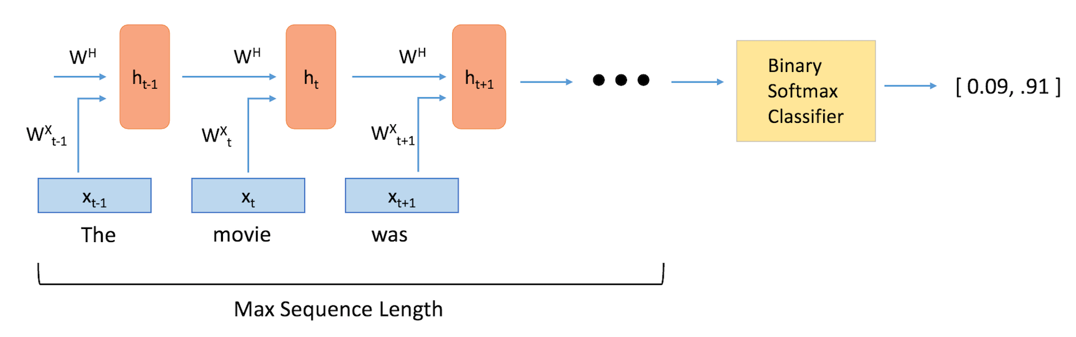
The main difference between feedforward neural networks and recurrent ones is the temporal aspect of the latter. In RNNs, each word in an input sequence will be associated with a specific time step. In effect, the number of time steps will be equal to the max sequence length.

Slide 23
Why use Lstm over classic RNN?
The problem lies in calculating these weights. The gradient calculated at each time instance has to be multiplied back through the weights earlier in the network. So, as we go deep back through time in the network for calculating the weights, the gradient becomes weaker which causes the gradient to vanish. If the gradient value is very small, then it won’t contribute much to the learning process.
Let’s say from the above diagram that we have calculated the error at time instance (t3). To update the weights of all the neurons that have participated in calculating the output at time instance(t3), we need to propagate through time till time instance (t0).
In a nutshell, if the sequence is long, then RNN finds it difficult to carry information from a particular time instance to an earlier one because of the vanishing gradient problem.

Slide 24
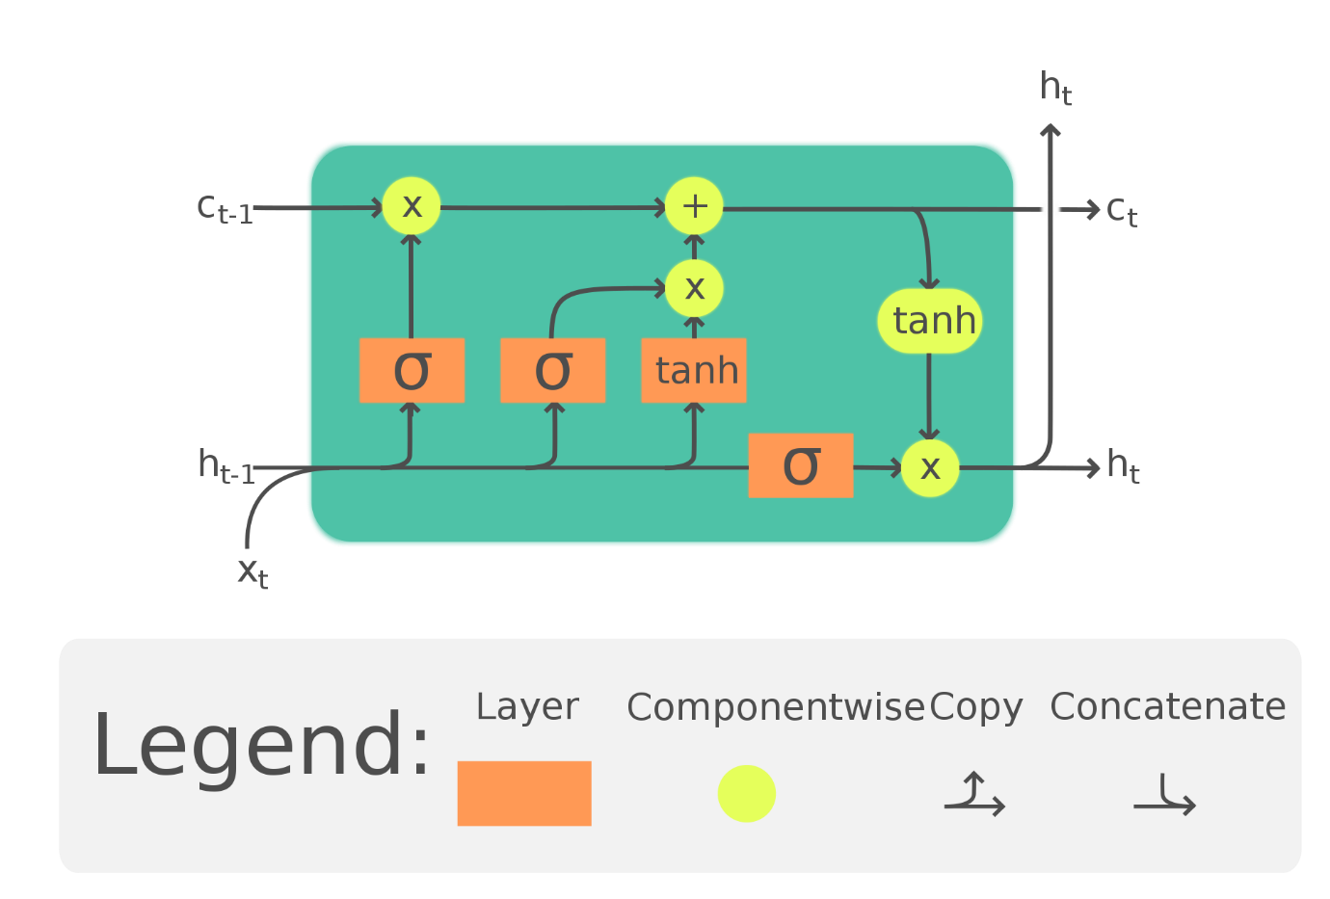
Solution given by Lstm
It has a memory cell at the top which helps to carry the information from a particular time instance to the next time instance in an efficient manner. So, it can able to remember a lot of information from previous states when compared to RNN and overcomes the vanishing gradient problem. Information might be added or removed from the memory cell with the help of valves.

Slide 25
Conclusion
This algorithm can be utilized in different fields to tackle some real-life issues like
Human error
Use of Physical Equipment
Time efficient
Reduce labour.
In this, we have successfully proposed a model to determine the dimensions of the object in real time.

Slide 26
Thankyou

